Slide 1
Into the Midst
Create a zoo habitat for gorillas using information about their original habitat
Pedro Souza– 7th grade

Slide 2
Project Challange
For this project I had to build a zoo habitat that is based on the original one in nature.
I had to reserch about factors that are present in the habitat and put them in mine.
Pedro Souza

Slide 3
Background Research
Environment – How their environment is like.
Climate change – How it affects the lives of the gorillas.
Food – What kind of food they eat.
Rest – How they rest
Visitors – How a good summary of the place would be.
Pedro Souza

Slide 4
Background Research (Sources)
https://www.gorillas-world.com/gorilla-habitat/
https://escholarship.org/content/qt8pg78231/qt8pg78231.pdf?t=nso4om
https://seaworld.org/animals/all-about/gorilla/diet/#:~:text=About%2086%25%20of%20their%20diet,ants%2C%20snails%2C%20and%20grubs.
https://www.gorillas-world.com/gorilla-feeding/
https://seaworld.org/animals/all-about/gorilla/diet/
Pedro Souza

Slide 5
Background Research (Sources)
https://gorillafund.org/gorilla-night-routines/
https://gorillafund.org/gorilla-night-routines/
https://courses.lumenlearning.com/englishcomp1v2xmaster/chapter/how-to-write-a-summary/#:~:text=Summary%20Writing%20Format&text=A%20summary%20is%20written%20in,to%20defend%20the%20main%20point
https://krex.k-state.edu/dspace/handle/2097/19110
Pedro Souza

Slide 6
Materials
Paper
Plastic
Ink
Pencil
Cardboard
Glue
Tape
String
Wood
Pedro Souza

Slide 7
Procedure for Building
Organize materials.
Organize space.
Made the shape of the habitat with card paper and tape, it has to be done of three walls and one floor, and the tape puts them together. The back wall has a height of 15cm tall and a length of 30cm, the right and left walls have a height of 15cm tall and a length of 20 cm, the floor has a length of 30 cm and width of 20cm.
Painted the box with ink in spray and watercolor, we used green, blue, brown, red, and black.
Cut the shape of the lake made with card paper, it was circular, but had some curves. The length was of 5-8cm.
Painted the lake with blue ink.
Left the structures to dry for one day.
Glue the lake on the floor of the habitat, near the front.
Pedro Souza

Slide 8
Procedure for Building
Cut a rectangular space on the front wall of the habitat. It is supposed to have a height of around 10cm and length of around 15-16cm.
Glue a piece of plastic of around that same size on the back of the wall, that is because it must cover the cut space.
Make the trees. Cut little pieces of sticks, maximum around 10cm, make a little shell with green paper and tape it on the stick.
Make a little circle of string, circle of around 3-5cm length, and tie it. Do one for each of the trees.
Get a piece of black paper, it can be all of the regular paper, that is, length of around 29.5cm and width of 21cm. Then make it like the shape of a rock.
You glue the trees around the habitat, and around each tree you put one circle of string, glue the tree in the middle space.
Pedro Souza

Slide 9
Procedure for Building
Glue the rock where the front wall meets the right wall.
Get another piece of plastic and cut it in a bowl-like shape, height of 2cm.
Glue it somewhere near the front wall.
Put some little seeds (or things that look like it) and little green pieces of paper to make the food.
Pedro Souza

Slide 10
Solution Summary
In order to make a solution I researched about the topic and that was produced in the habitat.
The result was a square-like habitat, I recreated the original vegetation of their original habitat, food, resting place, space where visitors can look at them, and a summary of the habitat to the visitors.
Pedro Souza

Slide 11
Project Outcome
In the outcome of the project I was able to create a habitat that included everything I researched about.
I accomplished my goals about the project, that was creating a comfortable space for animals in which they can live with their natural habitat resources.
Pedro Souza

Slide 12
Benefits of the Project
Creates a space for gorillas that has essential things they need to survive in nature.
Allows people to understand about it and about the gorilas.
Gives others information about how gorillas live and what they use to do.
Pedro Souza

Slide 13
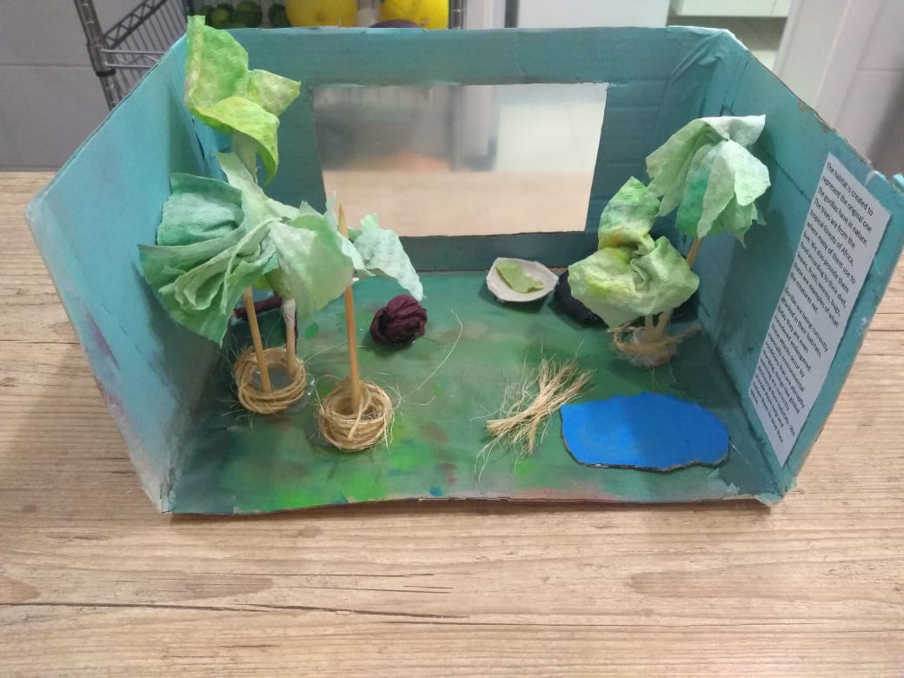
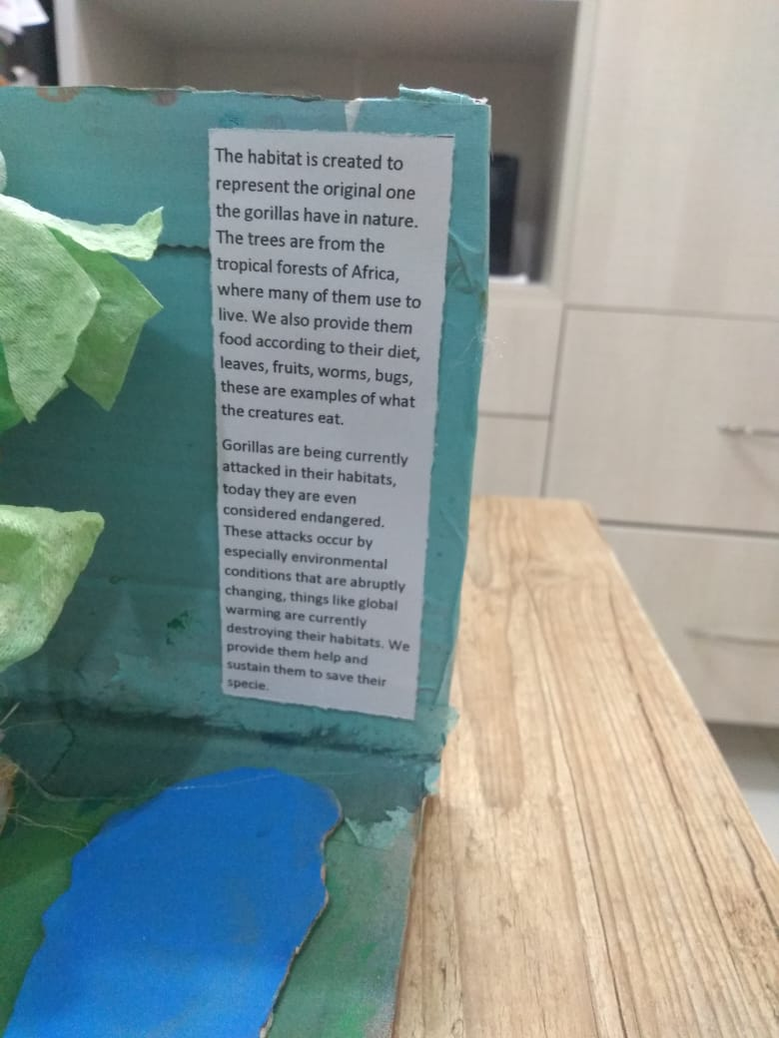
Photo Story
Pedro Souza

Slide 14
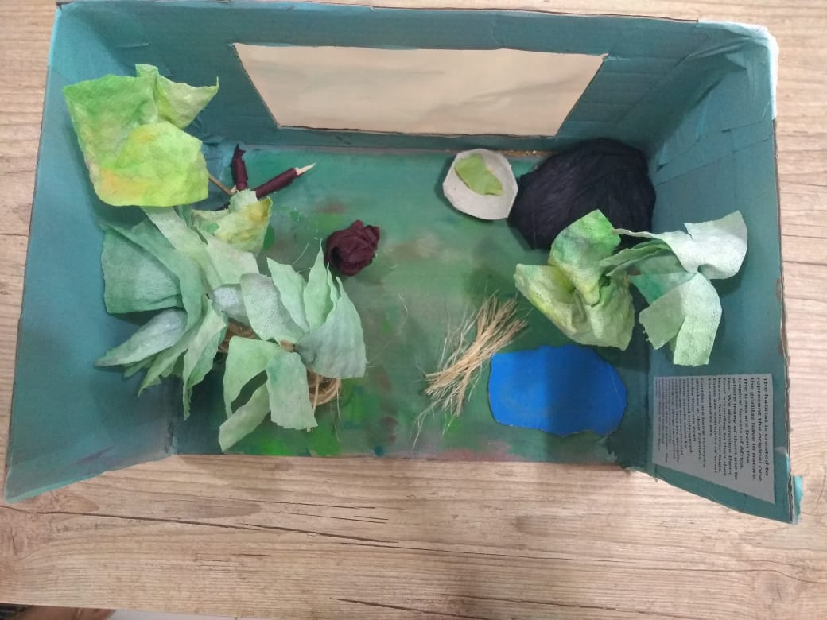
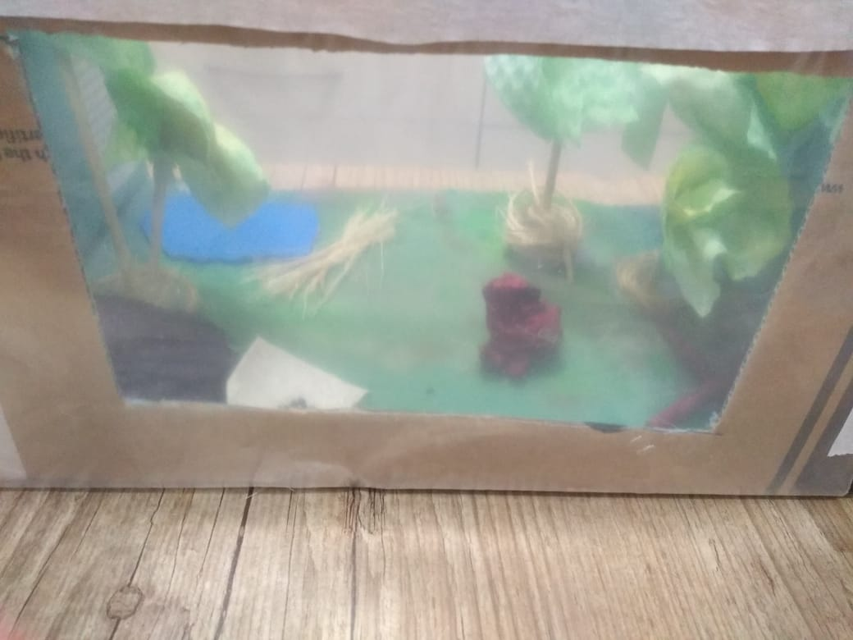
Photo Story
Pedro Souza

