Slide 1
STEM project
Julia Oliveira
7th grade

Slide 2
Create a Home: Bird House Problem : The bird specie American Gold Finch needs a suitable home to live in

Slide 3
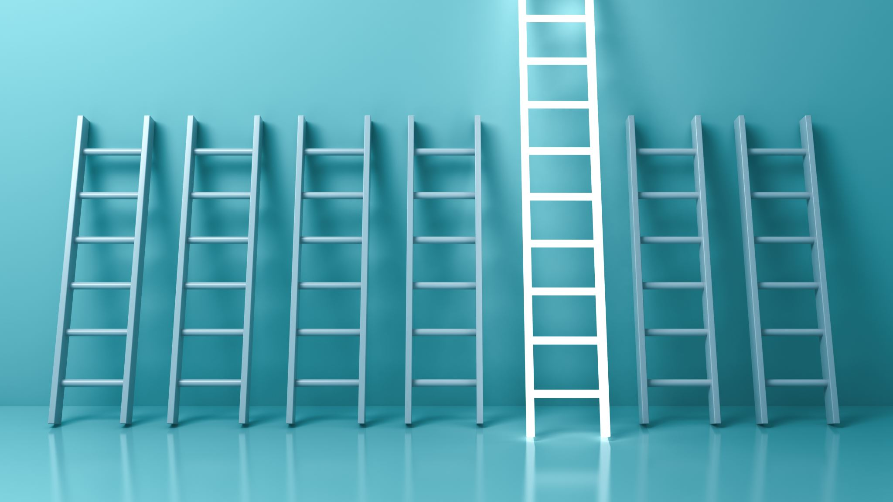
Challenge :Build an appropriate home to suit the bird’s needs.

Slide 4
Background Research
Their diet mainly consists of seeds, especially sunflower, and water.
They have a life span of an estimated 11 years.
They grow to 5 inches in length once they reach adulthood.
They are an North-American species of bird and belong to the finch family.
It has a yellow coloring around the body with black and white wings.

Slide 5
Materials
2 meters of common white string
Liquid white glue
Popsicle sticks
Super glue
Cardboard cut out
Small food bowls
Bird food
Hay
Bottle feeder
Duct tape
Plants

Slide 6
Procedure
1.First, I gathered my most important materials that would help me build the structure of the house: popsicle sticks, liquid glue, superglue and string.
2.I built the base which would be the bottom by gluing popsicle sticks side by side and using smaller ones to maintain it firm.
3.To build the walls I also glued the popsicle side by side until I had 6 different walls.
4.Then, I glued two walls together to create a thicker wall. I did that until I had three thick walls.
5.Next, I built the ceiling with two large plaques of popsicle sticks that I joined together with small pieces of string and glue to keep it flexible into the shape I wanted.
6.Afterthat, I put together the walls onto the base with superglue and glued the ceiling onto the top once the walls were dry and sturdy.
7.Then, once the house was in place, I began making sure it would stay up by putting some tape onto the walls and ceiling.
8.Next, I started gluing small pieces of plant and leaves onto the sides of the house with normal liquid glue and waited for them to dry.
9.After, I started placing the plastic bowl for food on the side, the hay one on the back wall and the bird water tube glued at the front of the house.
10.Lastly, I filled the house with a little hay, put bird food on the bowls, and glued a piece of cardboard below the house to keep it sturdy.

Slide 7
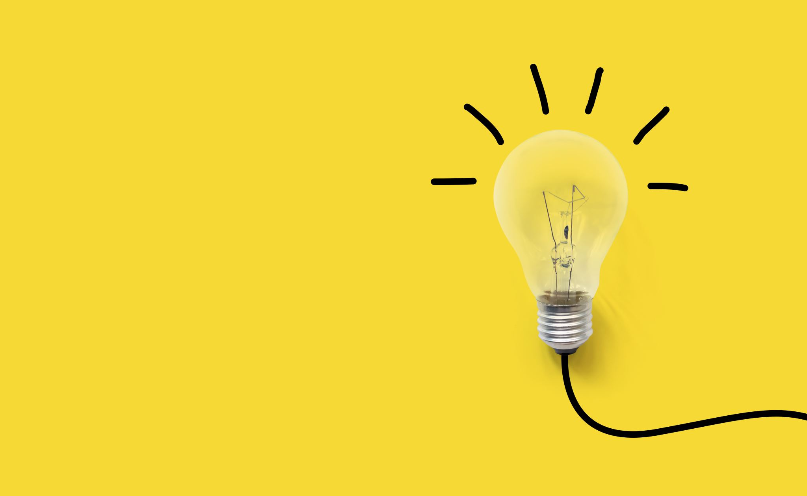
Solution Summary
The solution to my challenge was I did a lot of research that would help me better understand what I had to do to give them a better home. In the building proccess I tried using materials that were safe and would cause zero harm to the birds. After I had built the house, I set it up in a place that would be better for the birds that might visit in terms of their safety and protection. I also set it up with food and water inside to lure them in.

Slide 8
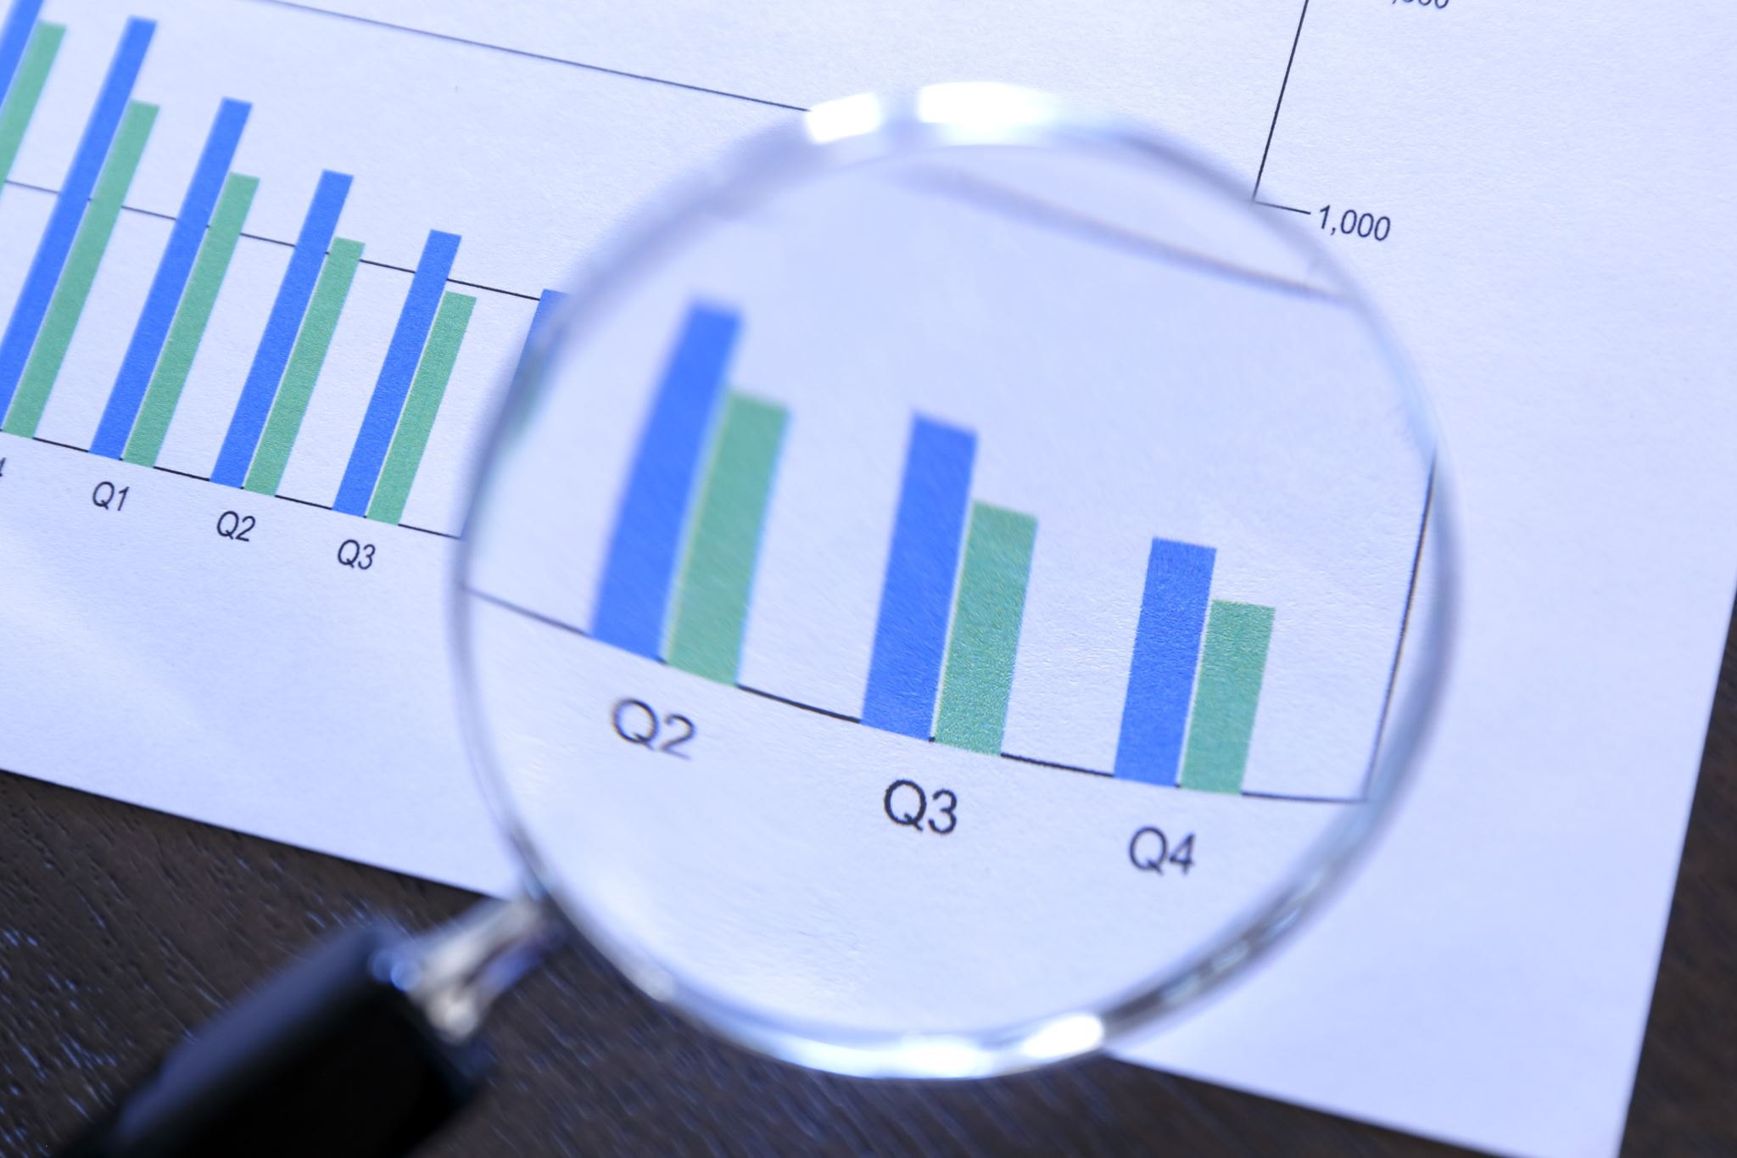
Data
days | Day 1 | Day 2 | Day 3 | Day 4 | Day 5 | Day 6
Birds visits | 0 | 1 | 3 | 2 | 1 | 2

Slide 9
Project Benefits
Keeps birds from starving because there is a steady income of food
Safer from predators and rain
Safer from hunters

Slide 10
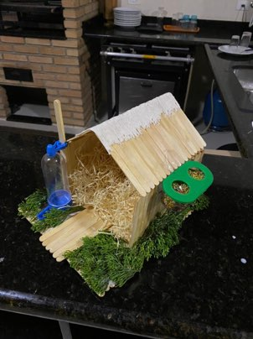
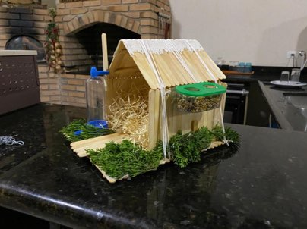
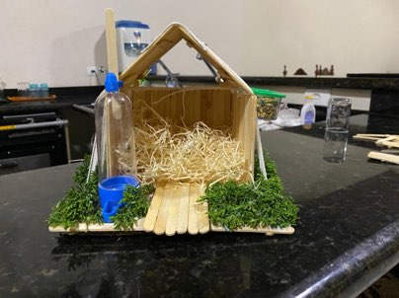
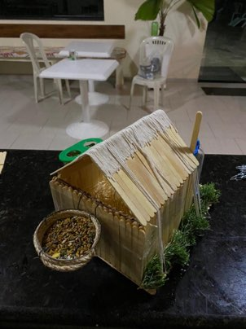
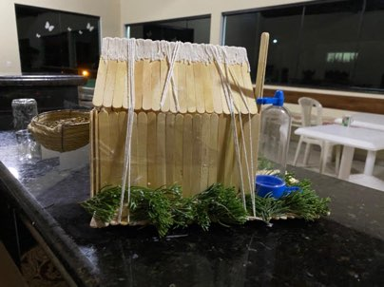
Photos ;)

