Slide 1
Solar Oven
Gabriel Yum 7th grade

Slide 2
Question & Challenge
The challenge was to completely melt and chocolate.
Is it possible to fry an egg without using fire? (Originally we needed to try and fry an egg but Mrs. Zuercher allowed us to completely melt an chocolate instead.)

Slide 3
5 Facts
That even on a cold day we may use solar energy.
The perfect temperture to cook an egg without burning and eating it raw is 160⁰ F.
A egg rottens in 3 weeks.
The best time of the day to use sunlight is at noon.
If the box or the thing your using it is so big it might be hard to cook.

Slide 4
Procedures
Steps:
I first cut the shoe box
Then I cut the top part
Then I opened the box so that it will be flat.
Then I put the alluminium on the flat box
Next I refold the box.
Then I put some tape so the the alluminum would be stuck to the box.
Later I found a kind of cup.
Next I covered the cup with black paper.
Finally I made a kind of lid with black paper.
And that’s it.

Slide 5
How I built it
I first cut the shoe box
Then I cut the top part
Then I opened the box so that it will be flat.
Then I put the alluminium on the flat box
Next I refold the box.
Then I put some tape so the the alluminum would be stuck to the box.
Later I found a kind of cup.
Next I covered the cup with black paper.
Finally I made a kind of lid with black paper.
I explained how I built and the materials together.

Slide 6
Experimental Plan
Question: The problem that I am solving is trying to melt na chocolate.
Design Process: First I will cover a box with alluminium that will put the sunlight to the chocolate and a black color something that will help put the sunlight to the chocolate.
Design Process: I think my prototype will look like a box covered with alluminium and on the middle something covered with black something.
Develope your Operatipnal Defination: If it is melted close to liquid or liquid.
I tried to have as manydata’s that I could have.
What really helped me was about what was the time of the day to use, what colors would help get the sunlight, and etc...

Slide 7
Projects Outcome
So I tried just once with a box covered with alluminium and a cup covered with black paper. I was succesful at the first try. So what I did was to see what place was the best place and I left it and every 5 minutes I took a picture. It started melting and at minute 25 it was totally melted.

Slide 8
Benefits
As I have spoken on the video some of the good things of this project is first we can help does with financial problem that may use less money to buy an oven and by a little better food instead. Another possitive reason is because it may be fun on making something to cook.

Slide 9
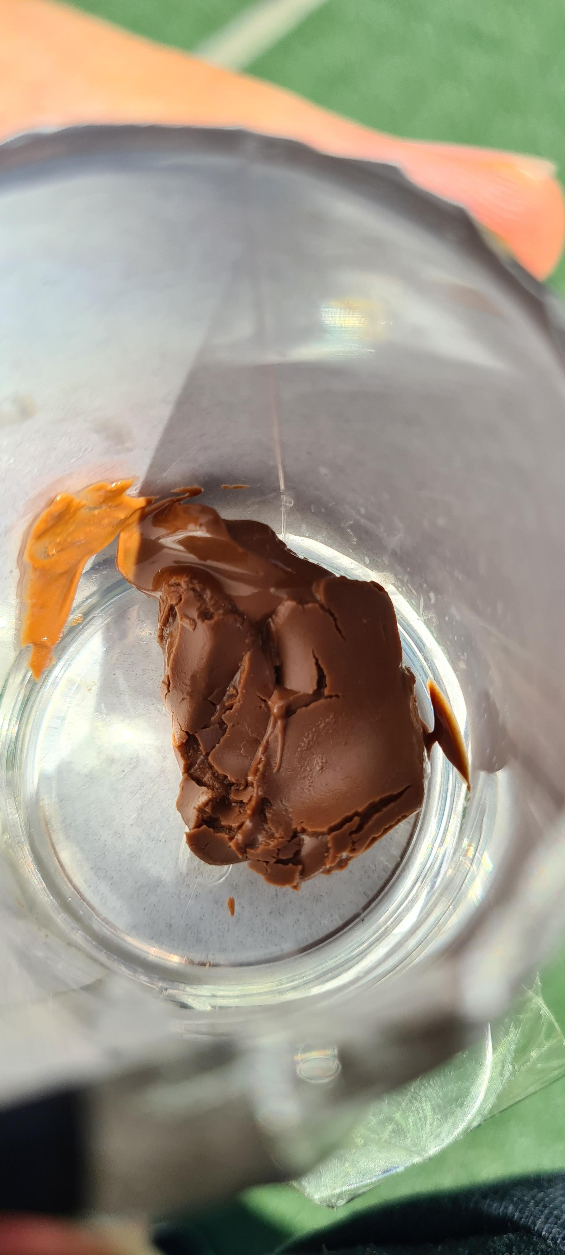
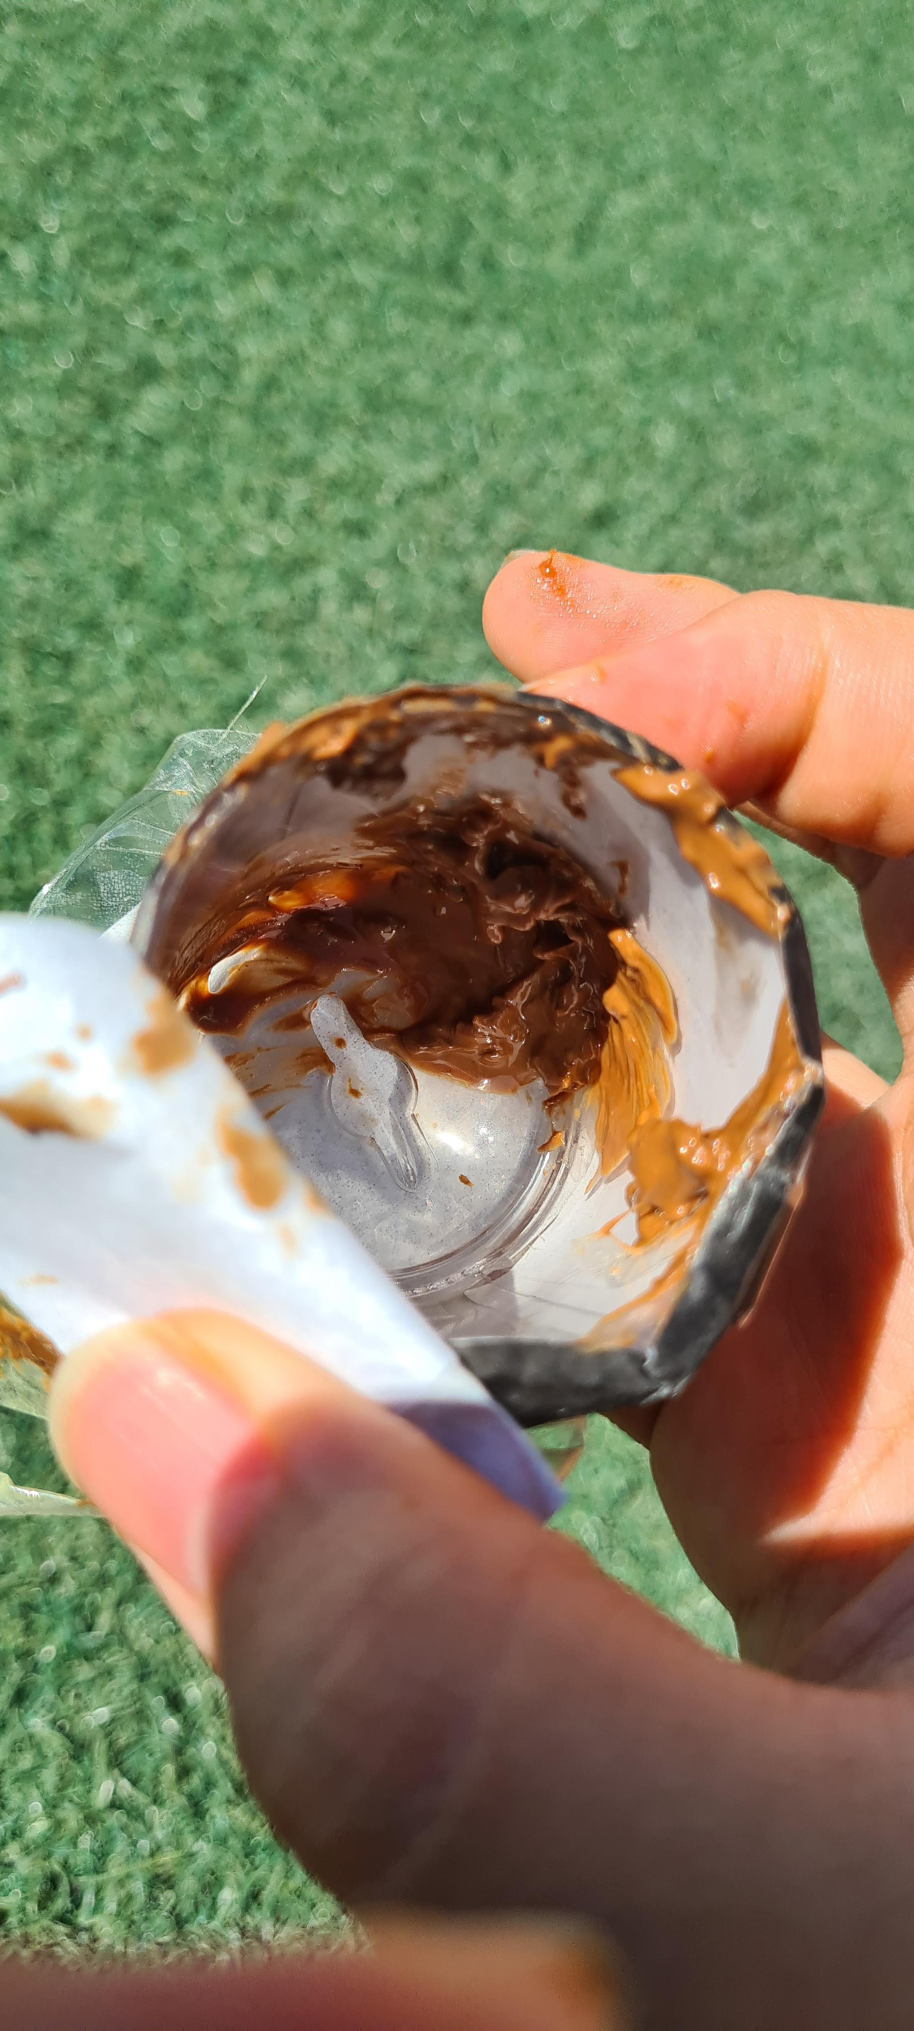
Pictures
This pictures are pictures while I was doing the experiment. It shows the start the middle and when It was finished.

