Slide 1
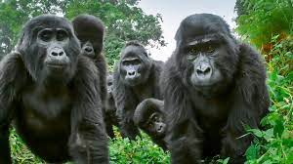
Gorilla habitat
How can I make a habitat for a gorila where they can live comfortabaly and safely?
By: David Choi
David

Slide 2
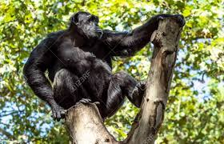
Challenges
What biotic and abiotic factors will you include in the habitat? What will they eat? How will they rest? How will they exercise?
David

Slide 3
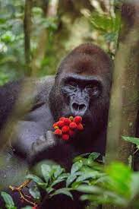
Backround reaserch
A gorila’s punch can bestrong enough to shattera skull.
Gorillas mainly maintain a vegetarian diet.
They eat up to 30kg of food each day.
A group of gorilas needs 4-8 km.
Gorillas exercise so I have to make a exercise place.
David

Slide 4
Materials list
Blue paint
Green paint
Brown paint
Green paper
Ping pong ball
Plastic
Fake wheat
String
Broken tiara
Hot glue gun
Tape
Rocks
David

Slide 5
Procedure
1. First, I started off by crafting the trees, I got the popsicle sticks and painted them brown. After painting it I glued the green paper above the stick to look like a tree.
2. Second, after making the trees I made the floor. I got a knife and cut the styrofoam into the shape I wanted and painted it green, a little bit of blue also for the water.
3. Third, I put the trees into the styrofoam and made the caves with a styrofoam ball and little rocks.
4. Forth, I made the base where the island was going to be, I got a piece of styrofoam and painted it green.
5. Fifth, after the paint dried I made the walls with plastic and glued the to the base with hot glue gun and with tape.
6. Sixth , with the fake wheat and string I made some toys, a food mechanism, torches, and little details to the walls.
7. I got a ping pong ball to cut it in half and use it as a bowl to give food to the gorillas, the legos were used as food, light, and a person.
8. At this point I wanted some details so I wanted like a river so I got plastic bags and painted it blue to act like water.
9. Nineth, I added vines to the trees with my broken tiara and painted the tiara green.
10. Finally I did some finishing touches like putting everything in place and the lighting to take the picture for submission!
David

Slide 6
Solution summary
Question: How can we make a place where gorillas can live but also where people can see them.
Design process: I will make a safe place for the gorillas to live, but also a safe place for the people to watch them.
Design preces: It will be like a big square where the gorillas can live in. There will be trees and water. The floor will be green and there will be plastic as the walls to represent bullet proof glass.
Develop your Operational Definition: If the habitat stands up right and doesn’t collapse.
Quantitative: I need 4 sides to make the habitat. The space will be about 25 cm each side.
Qualitative: Gorilla lives in a forest biome. They lake large spaces. They eat a lot.
David

Slide 7
Outcome
The Project is about 45cm each side.
It is 16 cm tall.
The walls are 30cm long each side.
Inside the walls are about 22cm long each side.
The Project is firm.
Its mostly green.
David

Slide 8
Benefits
With this Project I learned more about gorilas. Also it helped on my creativity and it was a fun thing to do. This might give some ideas for others as well.
David

Slide 9
Photos
1617976073.873162.jpg
1617976049.889742.jpg
1617976059.140147.jpg
David

